Slide 1
Missing Data with Multilevel Modeling
EDUC 8825 Advanced Data Analysis
W. Joel Schneider

Slide 2

I made heavy use of this freely available book in this presentation.
https://stefvanbuuren.name/fimd/

Slide 3
Obviously the best way to treat missing data is not to have them.
—Orchard and Woodbury (1972, p. 697)

Slide 4
Even samples with so-called complete data have missing rows.
What do you think a sample is?
Missing rows of data is the whole point of sampling.

Slide 5
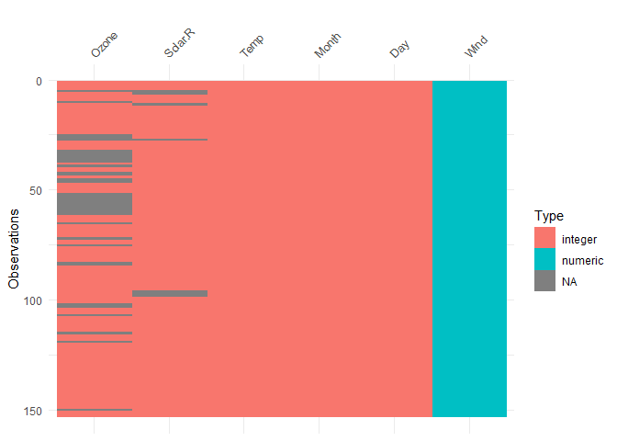
Visualizing Missing Data with visdat Package
library(visdat)
vis_dat(airquality)

Slide 6
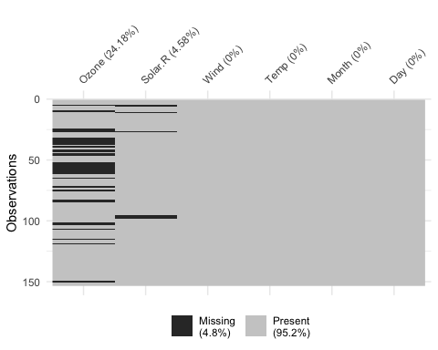
Visualizing Missing Data with visdat Package
library(visdat)
vis_miss(airquality)

Slide 7
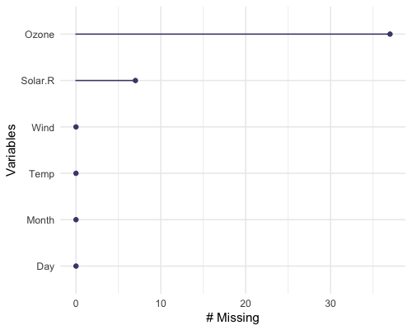
Visualizing Missing Data with visdat Package
library(visdat)
vis_miss_var(airquality)

Slide 8
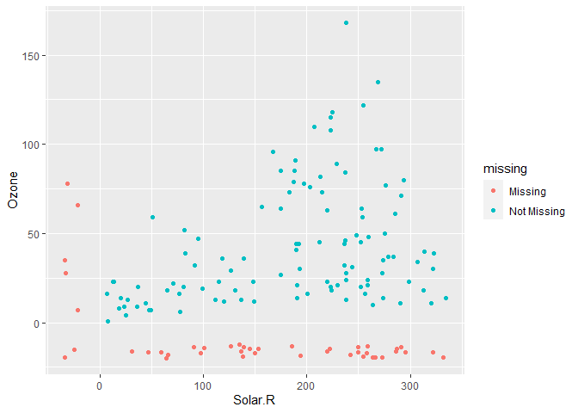
Visualizing Missing Data with the naniar Package
library(naniar)
library(tidyverse)
ggplot(airquality,
aes(x = Solar.R, y = Ozone)) +
geom_miss_point()

Slide 9
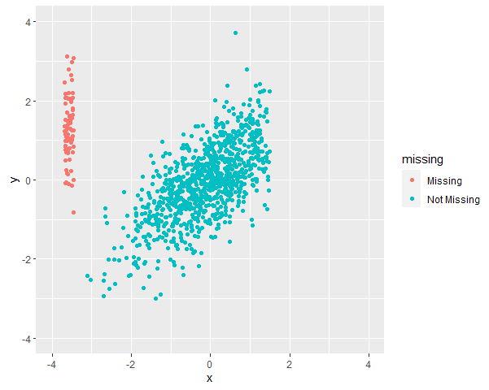
Visualizing Missing Data with the naniar Package
d %>%
ggplot(aes(x,y)) +
geom_miss_point() +
coord_fixed(xlim = c(-4,4),
ylim = c(-4,4))

Slide 10
Visualizing Missing Data with the naniar Package
simstandard::sim_standardized(
n = 1000,
"x ~~ .7 * y") %>%
mutate(xmissing = x > 1.5,
x = ifelse(xmissing == 1, NA, x)) %>%
ggplot(aes(x,y)) +
geom_miss_point() +
coord_fixed(xlim = c(-4,4),
ylim = c(-4,4))

Slide 11
Wide Data Vs. Long Data
Wide Data Used in SEM
Long Data Used in Mixed Models
id | x_1 | x_2 | y_1 | y_2
1 | 5 | 6 | 2 | 1
2 | 6 | 9 | 9 | 10
3 | 2 | 4 | 4 | 6
4 | 3 | 4 | 8 | 7
id | time | x | Y
1 | 1 | 5 | 2
1 | 2 | 6 | 1
2 | 1 | 6 | 9
2 | 2 | 9 | 10
3 | 1 | 2 | 4
3 | 2 | 4 | 6
4 | 1 | 3 | 8
4 | 2 | 4 | 7

Slide 12
Wide Data Vs. Long Data with Missing Data
Wide Data Used in SEM
Long Data Used in Mixed Models
id | x_1 | x_2 | y_1 | y_2
1 | 5 |  | 2 | 1
2 | 6 | 9 | 9 | 10
3 | 2 | 4 |  | 6
4 | 3 | 4 | 8 | 7
id | time | x | y
1 | 1 | 5 | 2
1 | 2 |  | 1
2 | 1 | 6 | 9
2 | 2 | 9 | 10
3 | 1 | 2
3 | 2 | 4 | 6
4 | 1 | 3 | 8
4 | 2 | 4 | 7
Unless we take preventative action, we will lose the entire row!
Will lose 1 row.

Slide 13

Rubin’s Taxonomy of Missingness
MNAR
Missing Not at Random
For unknown reasons, the probability of being missing is unequal.
MAR
Missing at Random
The probability of being missing depends on known predictors.
MCAR
Missing Completely at Random
The probability of being missing is the same for all cases.
Rubin, D. B. (1976). Inference and missing data. Biometrika, 63(3), 581–590.

Slide 14
Solutions to the Missing Data Problem
Listwise Deletion: Remove the entire row if any value in it is missing
id | x_1 | x_2 | y_1 | y_2
1 | 5 |  | 2 | 1
2 | 6 | 9 | 9 | 10
3 | 2 | 4 |  | 6
4 | 3 | 4 | 8 | 7
Advantages: Easy. The default method in most software
Disadvantages: Wasteful. Biases results if not MCAR.

Slide 15
Solutions to the Missing Data Problem
Pairwise Deletion: Estimate covariance matrix from all pairs of variables
id | x_1 | x_2 | y_1 | y_2
1 | 5 |  | 2 | 1
2 | 6 | 9 | 9 | 10
3 | 2 | 4 |  | 6
4 | 3 | 4 | 8 | 7
Advantages: Less wasteful. Uses all available information
Disadvantages: Biases results if not MCAR.

Slide 16
Solutions to the Missing Data Problem
Mean imputation: Replace all missing data with the variable’s mean
id | x_1 | x_2 | y_1 | y_2
1 | 5 | mean(x_2) | 2 | 1
2 | 6 | 9 | 9 | 10
3 | 2 | 4 | mean(y_1) | 6
4 | 3 | 4 | 8 | 7
Advantages: Easy.
Disadvantages: Really distortions the data. Reduces SD and correlations
DO NOT USE!!

Slide 17
Solutions to the Missing Data Problem
Regression imputation: Replace all missing data with the predicted value from other variables
id | x_1 | x_2 | y_1 | y_2
1 | 5 | predicted | 2 | 1
2 | 6 | 9 | 9 | 10
3 | 2 | 4 | predicted | 6
4 | 3 | 4 | 8 | 7
Advantages: More realistic missing values. Unbiased if MAR.
Disadvantages: Reduces variance and biases correlations upwards
DO NOT USE. Type I Error Factory: Creates results that are “too good to be true.”

Slide 18
Solutions to the Missing Data Problem
Stochastic regression imputation: Replace all missing data with the predicted value from other variables + error
id | x_1 | x_2 | y_1 | y_2
1 | 5 | Predicted + error | 2 | 1
2 | 6 | 9 | 9 | 10
3 | 2 | 4 | Predicted + error | 6
4 | 3 | 4 | 8 | 7
Advantages: More realistic missing values. Unbiased if MAR.
Disadvantages: Only correct if errors meet assumptions

Slide 19
Solutions to the Missing Data Problem
Last Observation Carried Forward (LOCF): Replaces missing longitudinal data with last known value
id | time | x | y
1 | 1 | 5 | 2
1 | 2 | 5 | 1
2 | 1 | 6 | 9
2 | 2 | 9 | 10
3 | 1 | 2
3 | 2 | 4 | 6
4 | 1 | 3 | 8
4 | 2 | 4 | 7
id | x_1 | x_2 | y_1 | y_2
1 | 5 | 5 | 2 | 1
2 | 6 | 9 | 9 | 10
3 | 2 | 4 |  | 6
4 | 3 | 4 | 8 | 7
Advantages: Convenient and Conservative
Disadvantages: Biased results even under MCAR

Slide 20
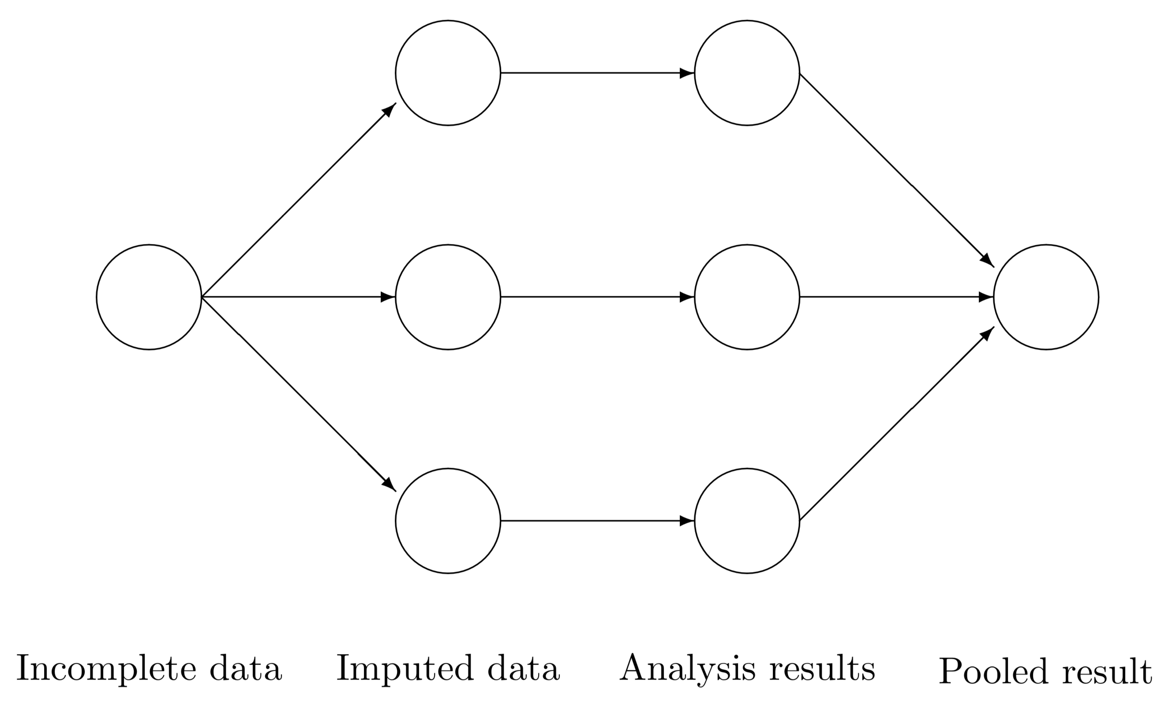
Solutions to the Missing Data Problem
Multiple Imputation with Chained Equations (MICE): Create plausible estimates for each missing value + plausible errors. Create multiple versions of the imputed data. Analyze all data sets and pool results.
id | x_1 | x_2 | y_1 | y_2
1 | 5 | Pred + error | 2 | 1
2 | 6 | 9 | 9 | 10
3 | 2 | 4 | Pred + error | 6
4 | 3 | 4 | 8 | 7
Advantages: “Solves the standard errors too small problem”
Disadvantages: MNAR still a problem.
Image Credit: Stef van Buuren (2018)
library(tidyverse)
library(mice)
imp <- mice(airquality, seed = 1, m = 20, print = FALSE)
fit <- with(imp, lm(Ozone ~ Wind + Temp + Solar.R))
summary(pool(fit))
#> term estimate std.error statistic df p.value
#> 1 (Intercept) -65.8782658 23.0377412 -2.852643 69.97033 5.696702e-03
#> 2 Wind -3.01897171 0.66252377 -4.556775 70.51194 2.125022e-05
#> 3 Temp 1.63483547 0.25107557 6.511328 75.99913 7.203792e-09
#> 4 Solar.R 0.05861581 0.02267832 2.584662 90.10797 1.135441e-02

Slide 21
Missing Data with lme4
Missing data imputed using MICE.
Assumes MAR (Missing at Random)
What about derived variables like cluster means?

Slide 22
MICE Principles
Fit model to observed data to obtain estimates of all parameters
Generate random draws from their posteriors.
For each missing value, calculate its expected value + a random error
Follow recommendations here:
https://stefvanbuuren.name/fimd/ch-multilevel.html
Tutorial:
https://www.gerkovink.com/miceVignettes/Multi_level/Multi_level_data.html

Slide 23
Missing Data with lavaan
Missing data in the outcome variable are handled “automatically” by full-information maximum likelihood:
Add missing = "ML" to fitting function
Assumes MAR (Missing at Random)

